Slide 1
Avinashilingam Institute for Home Science and Higher Education for Women, Coimbatore
Library Catalogue Search: How to Search a Book

Slide 2
Introduction
This guide gives a quick introduction to the Library Catalogue. You can use the Library Catalogue to:
Find out which books and other resources are in stock in the Library
Look at recent additions to stock

Slide 3
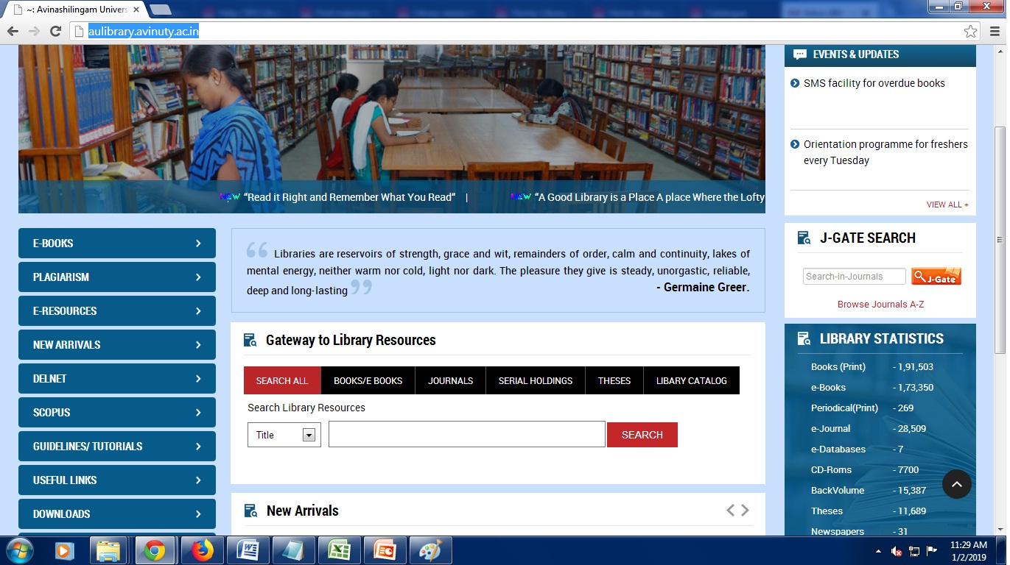
Getting started
Step 1:
Click open the Library website http://aulibrary.avinuty.ac.in. The main page of the website has Gateway to Library Resources there click the Library Catalog or
The Catalogue can be directly accessed through the website library.avinuty.ac.in
Click Here

Slide 4
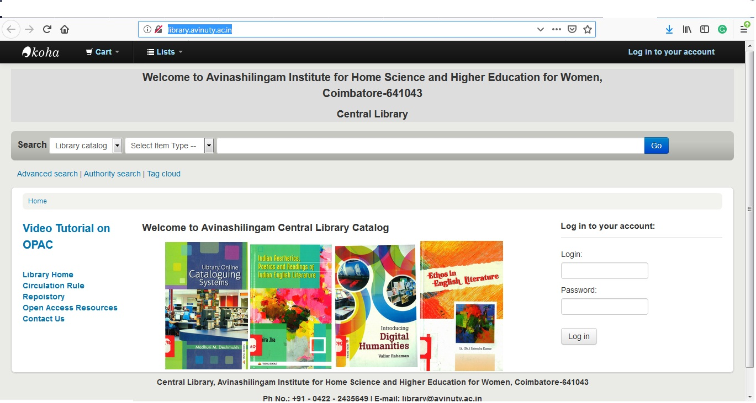
Basic Search
Step 2: In the main page of the Library Catalogue . The basic search can be made

Slide 5
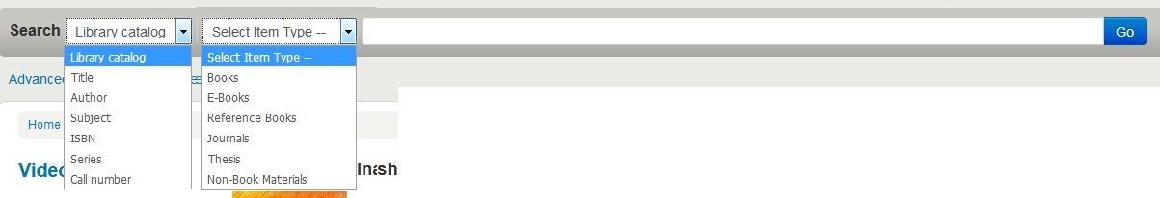
Using Basic Search : Do a Title / Author/ Subject Search
Step 3: Enter the Search Term and click “Go”
Provide the Search Term
Select the type of material to search
Select Title / Author/Subject
Click Here to Search
Select the Choice of Search Title/ Author/Subject/ISBN/ series/Call Number
Select the Type of material you are searching for Books/ EBooks/Journals/
Thesis/ Non-Book Materials
Type the search term your are searching for and click the button “GO”

Slide 6
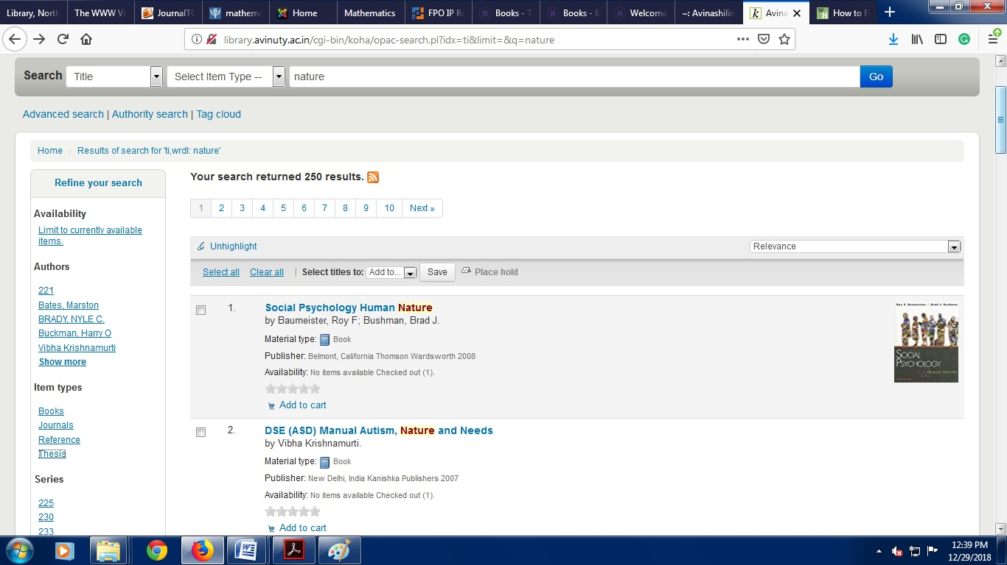
Viewing your results
Step 4: The Library Catalogue displays a list of the items matching your search.
Search Term
Book Image
Book
Title, Author, Publisher, Availability
Filter by Author
Filter by Item Type

Slide 7
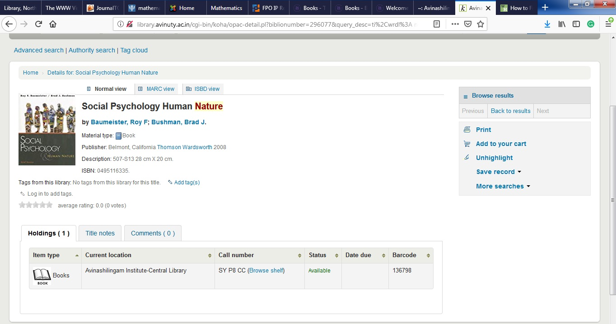
Book Details
Step 5: Click the title to see the location and availability of the item
Call Number
Accession Number
Availability

Slide 8
Advanced Search
Step 6: In the main page of the Library Catalogue . The advanced search can be made If you know the author and title of a book and want to search that specific book then use the advanced search option
Click here

Slide 9
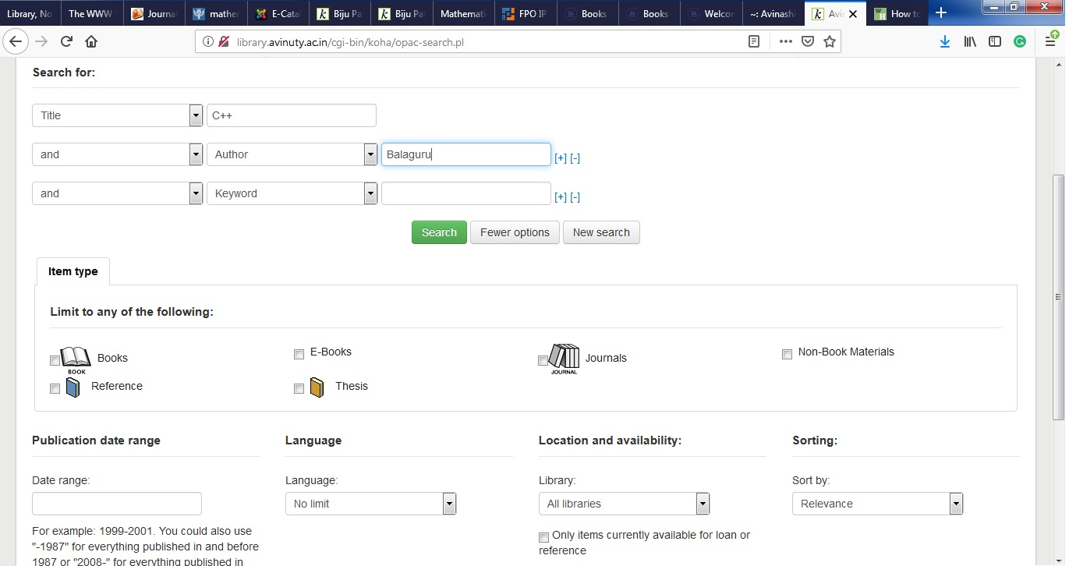
Search Window
Step 7: You can select the Field you are searching for and type the search term you are looking for and use the “and“ operator to combine the result
The result can be limited by item type, year, language

Slide 10
Search Tips
In a words or phrase search do not use words like ‘the’ ‘and’ ‘a’
and ‘of’.
Check your spelling - is there a different way to spell the word e.g.
organisation or organization. Use the wildcard symbol (?) for the
unknown letter such as organization.
This will find both spellings of the word.
Try searching the first few words rather than the whole title.
Clicking on the hyperlinked author’s name will show you more
resources by the same author.
Once you have found a useful book on the shelves, browse the
nearby books as they are likely to be on a similar topic.

